Slide 1
Solar Energy
By: Endrit Mehmetaj, Nate Scott, Taylor Cooley

Slide 2
Advantages and Disadvantages
Advantages
Clean alternative for electricity as opposed to fossil fuels
Once a system is in place, the fuel is free and plentiful
18 days of sunshine contains the same amount of energy as all the Earth's reserve of fossil fuels combined
Disadvantages
No energy production during the night time
Not as effective during inclement weather
Very costly to create the infrastructure to harness the power of the sun

Slide 3
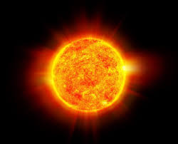
Type of Primary Source
Solar energy’s primary energy source is the sun. Solar energy is a renewable source that will last until it burns out which is billions of years away.e it can get infinite amounts of energy as long as the sun shines.

Slide 4
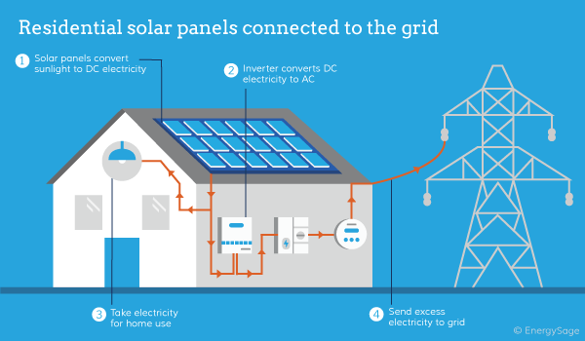
Method of Processing Energy

Slide 5
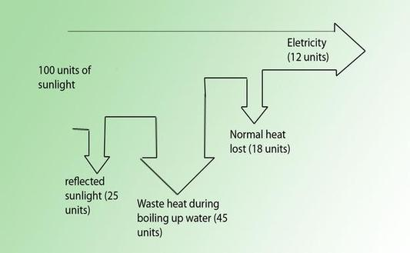
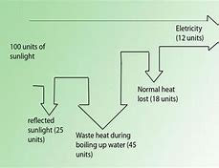

Slide 6
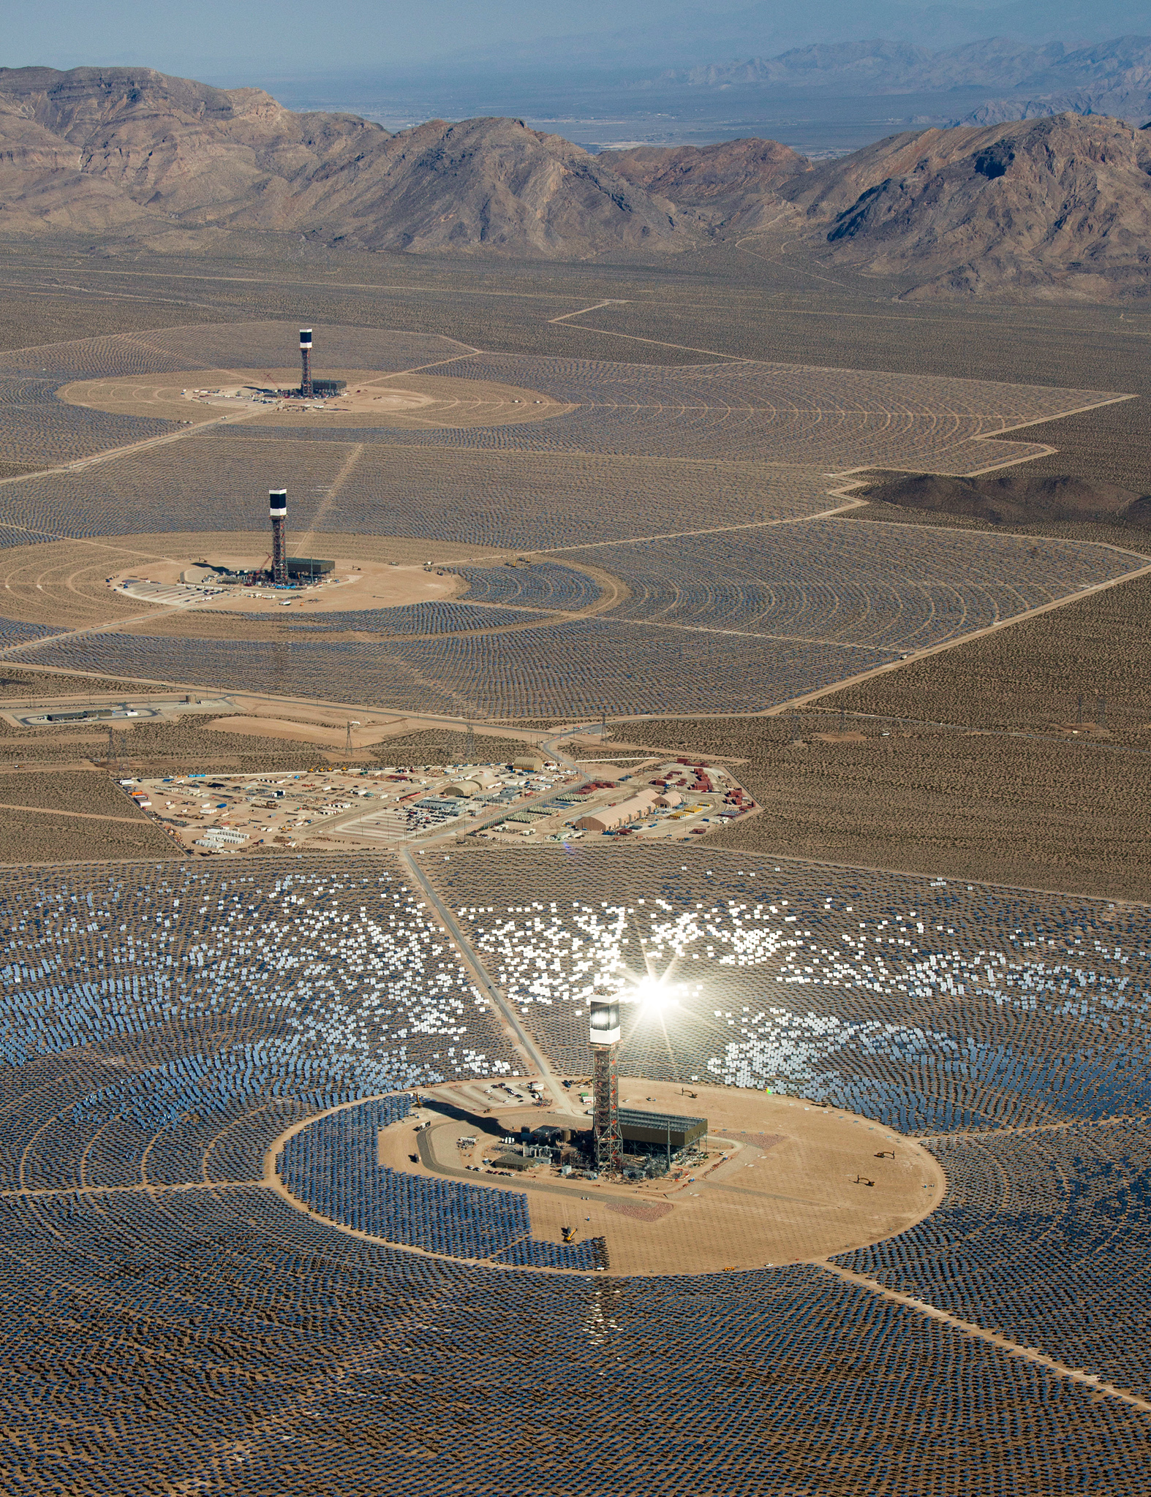
Miscellaneous
According to the online article “Solar Energy Facts”, solar energy can be used for multiple purposes such as creating salt from sea water, timing plant cycles, and helping plants create chemical energy. Another interesting fact is that space missions by various countries have used solar energy to power their ships. The largest solar power plant covers 1,000 acres and is located in the Mojave Desert in California. Lastly, the earth receives around 1,366 watts of direct solar radiation per square meter which we then can utilize to produce electricity and many other useful resources.

Slide 7
Important Formulas
MC(Tf-Ti)
Pin = IA
E= Pt
P= Watts= J/s
Power in / Power Out

Slide 8
Sources
40 Facts About Solar Energy.” Conserve Energy Future, 8 May 2017, www.conserve-energy-future.com/various-solar-energy-facts.php.
Solar Energy Sankey Diagram .” Shertam-Jouleisland.weebly.com, shertam-jouleisland.weebly.com/uploads/1/9/8/0/19804537/2390368.jpg?533.
· https://www.livescience.com/41995-how-do-solar-panels-work.html
· https://news.energysage.com/how-much-does-the-average-solar-panel-installation-cost-in-the-u-s/
· https://www.seia.org/states-map
https://www.researchgate.net/figure/Sankey-diagrams-of-solar-plant-annual-energy-production-left-medium-size-power-plant_fig7_326078696
https://www.ucsusa.org/clean-energy/renewable-energy/how-solar-energy-works
https://www.nationalgeographic.com/environment/global-warming/solar-power/

